Slide 1


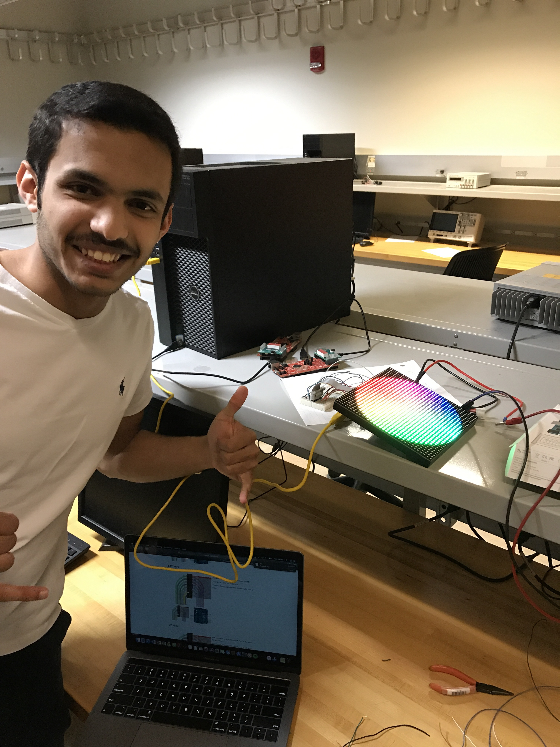
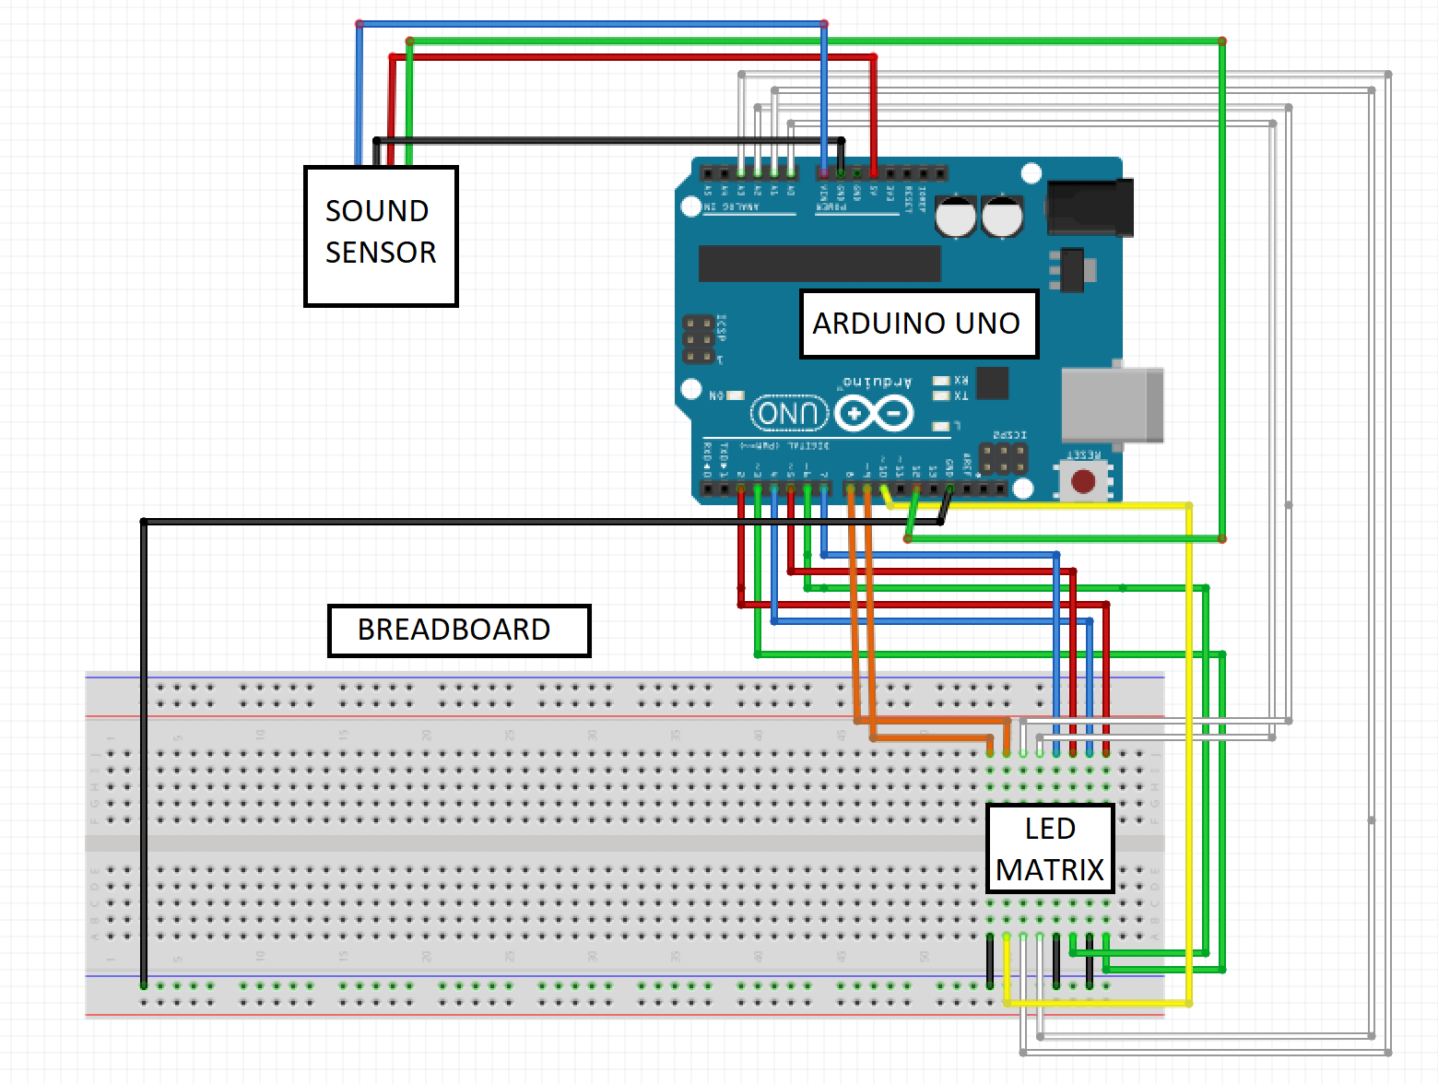
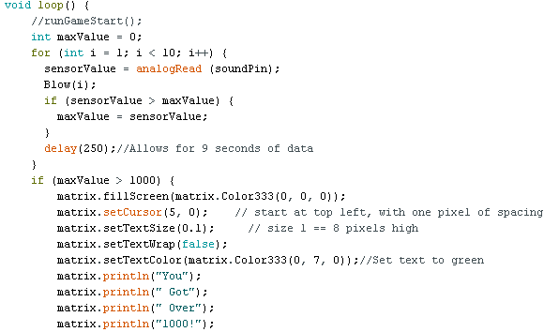
EECS 388 Embedded Systems
University of Kansas
Sound Solutions
Blake Morrell, Abdullah Alotibi, Charlie Carr, Josh High, Warren Bower, Chris Benjamin
Abstract
Background
Nowadays, audio is often a supplement to entertainment. The experience our device provides is directly related to audio input. This is different from other entertainment platforms such as a baseball game on TV. A commentator’s audio might enhance the overall quality of the product, but is not the primary focus.
Embedded Systems Concepts
- DAC (Output) - ADC (Input) - Code libraries
- RGB (Colors) - GFX (Graphics)
- Breadboard - Arduino (Microcontroller)
Sound Solutions is a new company that was founded by six EECS students at the University of Kansas. Our team is capable of creating a product that will accurately detect the loudness of sound. The JAWB2C6 seeks to provide multiple sound-related functions, yet the company’s first objective is to design a system that detects sound input and display it on LED matrix. To make that fun, we altered Sound Solutions to a game. From here, the user may scream or yell into the microphone attempting to achieve the highest intensity.
Approach
Evaluation
In all, the components cost close to $150. The new sound sensor allows intense inputs and ignores small inputs. To receive an output, the user must blow into the sound sensor. While the product does not operate as originally intended, the output is still based off the intensity of the input.
Conclusion
The main problem that Sound Solutions ran into was the quality of the sounds sensor. While the code worked properly, the sensor only detected an input when someone blew into the sensor. In the end, our goal to display an output based on input intensity was achieved.
Problem
People crave entertainment. The JAWB2C6 is simple to understand and easy to use. This device aims to expand the way humans look at sound. In this game, sound becomes a quantity. Intense inputs will produce a higher score.
References
- Burgess, Phillip. “32x16 And 32x32 RGB LED Matrix.” Test Example Code | 32x16 and 32x32 RGB LED Matrix | Adafruit Learning System, 11 Dec. 2012, learn.adafruit.com/32x16-32x32-rgb-led-matrix/test-example-code.
- Scuda, Ulli, et al. “Using Audio Objects and Spatial Audio in Sports Broadcasting.” MPEG-H Audio Alliance, 2014, www.mpeghaa.com/papers/AES57_scd_MPEGH_SportsTV_FinalSubmission.pdf.

